Slide 1

MAZE PROBLEM
Presented by :
Gauri Pandit-1DS17CS038
Divya P Hathwar- 1DS17CS035
Chandana Vijayakumar-1DS17CS033

Slide 2
ABSTRACT
In this given project, we solve the maze problem in C data structure using Backtracking .
Considering a matrix of size N*N with source position at (0,0) and destination at (N-1,N-1) in a 2D array.
Some of the positions in the array are marked as 0 which are blocked cells, rest being marked 1.
If the paths possible the output is printed, including to this, the number of possible path that can be taken is printed.

Slide 3
INTRODUCTION
For the maze problem, We make use of array, which is collection of elements of same data type referenced under a single name.
A Maze is a network of paths and hedges designed as a puzzle through which one has to find a way.
Backtracking is a general algorithm for finding all (or some) solutions to some computational problems, and abandons a candidate ("backtracks") as soon as it determines that the candidate cannot possibly be completed to a valid solution .

Slide 4
ALGORITHM Algorithm to generate paths
The Naive Algorithm is to generate all paths from source to destination and one by one check if the generated path satisfies the constraints.
while there are untried paths
{
Generate the next paths
If this path has all blocks as 1
{
Print this path
}
}

Slide 5
Backtracking Algorithm
if destination is reached
print the solution matrix
else
{
Mark current cell in solution matrix as 1
Move forward in the horizontal direction and recursively checks if this move leads to a solution.
If the move chosen in the above step doesn’t lead to a solution then move down and check if this move leads to a solution.
If none of the above solutions works then unmark this cell as 0 (BACKTRACK) and return false
}

Slide 6
Algorithm to count the number of ways
We can recursively compute grid[i][j] using below
formula and finally return grid[R-1][C-1]
// If current cell is a blockage
if (maze[i][j] == -1)
maze[i][j] = -1; // Do not change
// If we can reach maze[i][j] from maze[i-1][j]
// then increment count.
else if (maze[i-1][j] > 0)
maze[i][j] = (maze[i][j] + maze[i-1][j]);

Slide 7
// If we can reach maze[i][j] from maze[i][j-1]
// then increment count.
else if (maze[i][j-1] > 0)
maze[i][j] = (maze[i][j] + maze[i][j-1]);

Slide 8
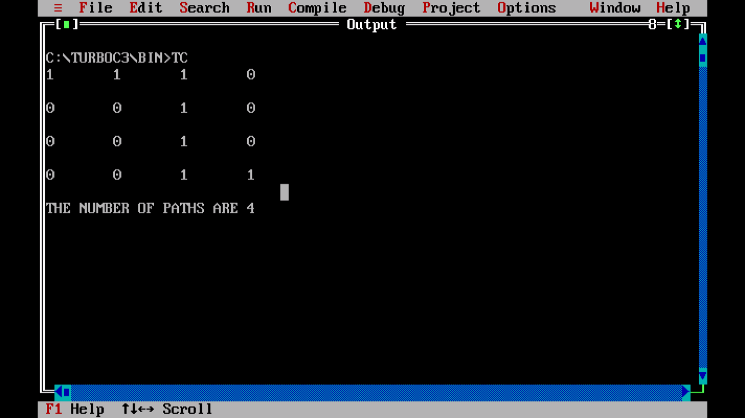
OUTPUT 1
The number of paths in this case is 4.

Slide 9
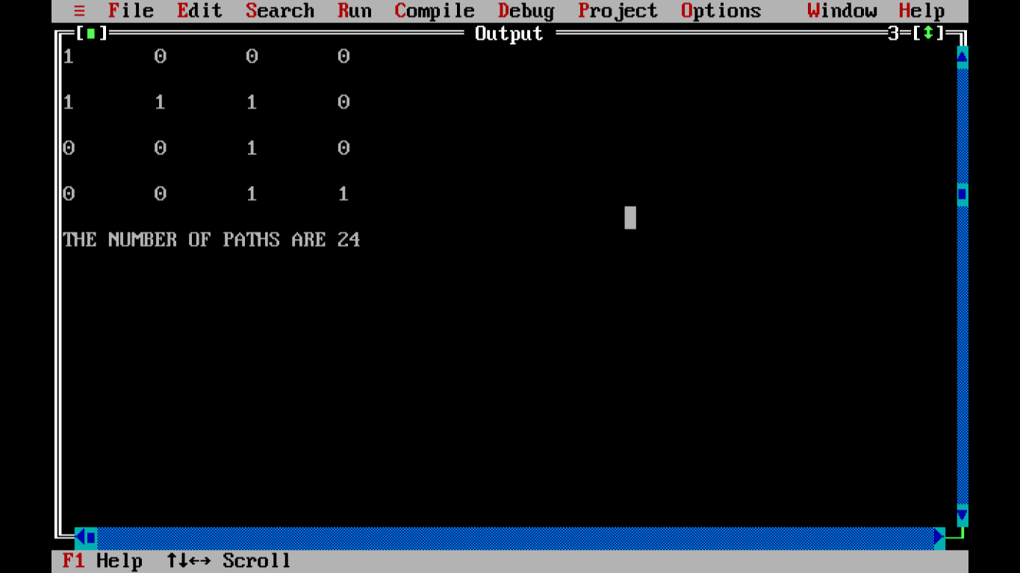
OUTPUT 2
The number of paths in this case will be 24.

Slide 10
CONCLUSION
We can use this code to successfully run the maze problem .Further changes done to the program can improvise and increase possibilities to recreate other games of this sort.

Slide 11
FURTHER ENHANCEMENTS
We can print all possible paths from source to destination along with the number of possible paths found. We can also print the shortest and longest path as well.

Slide 12
REFERENCES
www.codesdope.com/blog/article/backtracking-to-solve-a-rat-in-a-maze-c-java-pytho/
www.geeksforgeeks.org/count-number-ways-reach-destination-maze/amp/

